Slide 1
Health system in India
Dr. Reshma Reghu
Assistant professor
Dept of Community medicine

Slide 4
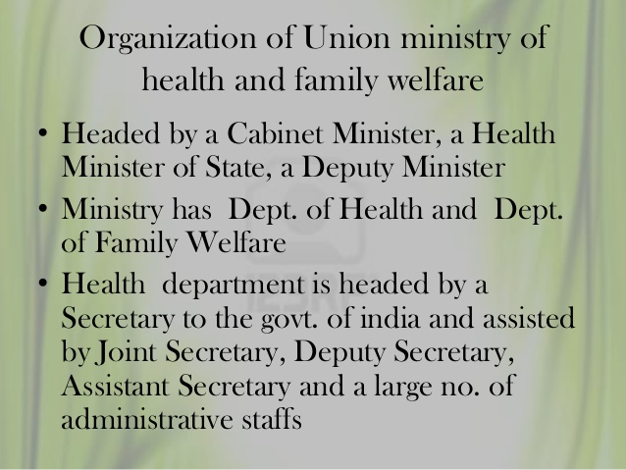

Slide 5
Department of Family Welfare
Created in 1966 within the ministry of Health & Family welfare
The Secretary to the Govt. of India in the Ministry of Health & Family Welfare is in overall charge of the Department of Family Welfare.
Assisted by an Additional Secretary & Commissioner (Family Welfare) and one Joint Secretary.

Slide 7
FUNCTIONS
The functions of the Union Health Ministry are set out in the seventh schedule of article 246 of the constitution of India under
The Union list
The concurrent list

Slide 9
CONCURRENT LIST
The functions listed under the concurrent list are the responsibility of both the Union and state governments.
The Centre and the States have simultaneous powers of legislation.

Slide 15
3. CENTRAL COUNCIL OF HEALTH
A large number of health subjects fall in the Concurrent list which calls for continuous consultation, mutual understanding and co-operation between the Centre and the States.
The Centre Council of Health was set up by a Presidential Order on 9 August, 1952 under Article 263 of the Constitution of India for promoting co-ordinated and concerted action between the Centre and the States in the implementation of all programmes and measures pertaining to the health of the nation.

Slide 19
The Regional Directors inspect all the branches of public health within their jurisdiction, irrespective of their speciality.
The Functional Directors are usually specialists in a particular branch of public Health such as mother and child health, family planning, nutrition, tuberculosis, leprosy, health education etc.
The Public Health Engineering Organization in most states is part of the Public Works Department of the State Government and the Chief Engineer of Pubic Health should have the status of an Additional Director of Health Services.

